Slide 1

Powerball Lottery
Bailey Korfhage, Ryan Fox, Caitlin Sizemore

Slide 2
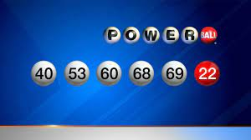
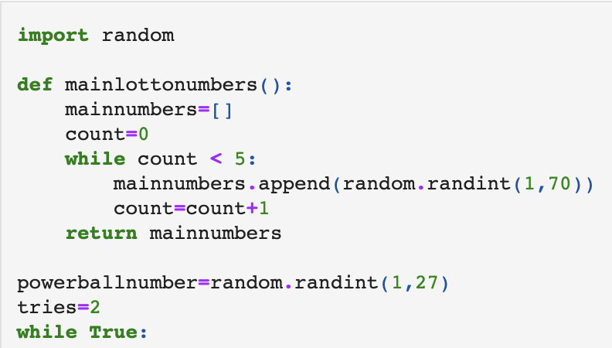
Setup Functions
Random – allows for random draw of lottery numbers
Def – This function allows us to draw 5 random lottery numbers and append them into a list
There is only one random poewrball number for each group of lottery numbers

Slide 3
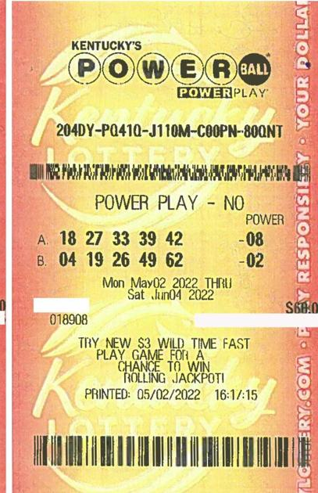
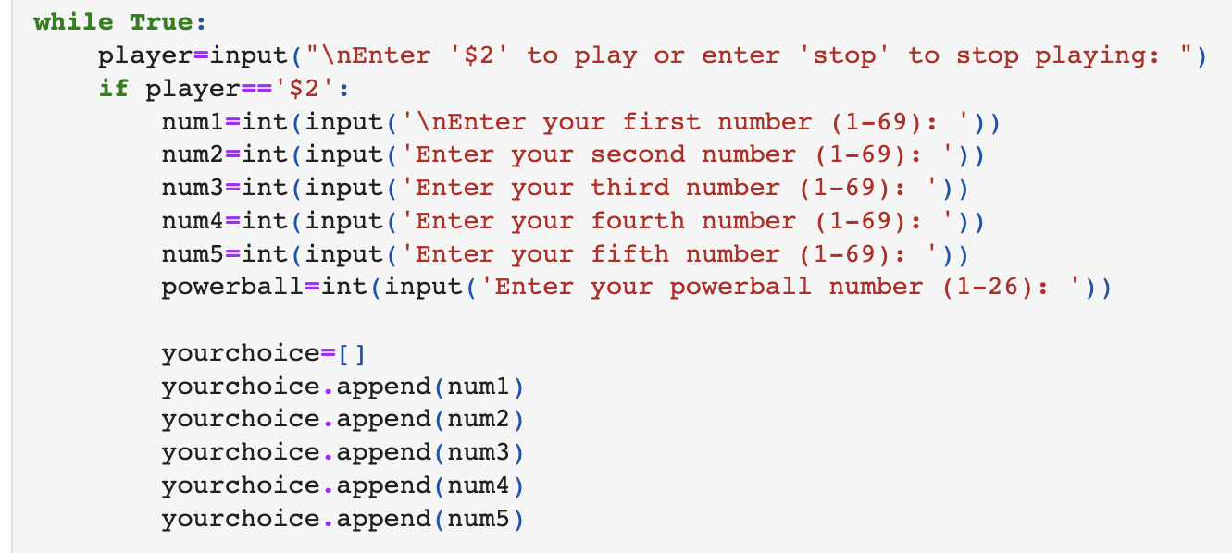
Winning Numbers/User input
The user will choose if they want to play for $2 each game
While the player has chosen to play or play again, they will input their 5 lottery numbers and one powerball number
The lottery numbers they input are appended to a list.

Slide 4

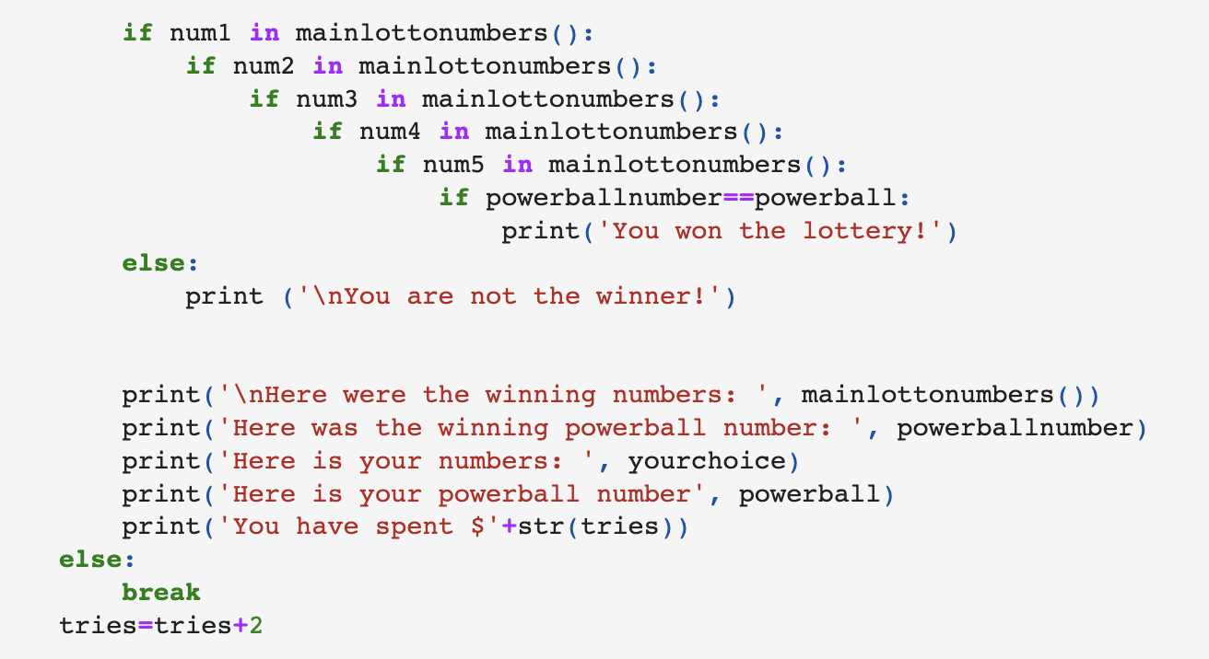
Game Functions and Outcomes
If functions: compare the list of random lottery numbers to the list of user inputs with an outcome of either win or lose.
The outcome is printed along with winning powerball number, winning lottery numbers, user lottery numbers, user powerball number, and total amount spent.
Else: allows user to stop playing

